Slide 1
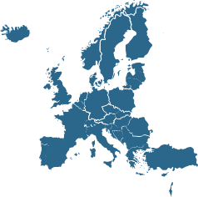
EUROMENE
European Network on Myalgic Encephalomyelitis/
Chronic Fatigue Syndrome
U.Berkis, E.Bole Strand, J.Castro-Marrero, E.Lacerda¹, L.Lorusso, M.Murovska, D.Pheby, C. Scheibenbogen, E. Shikova-Lekova
¹Dr. Eliana M Lacerda – Co-Chair CA15111 EUROMENE
London School of Hygiene & Tropical Medicine
October - 2016

Slide 2
Overview
Background
  Contextual and scientific challenges
EUROMENE proposal
  Aims/objectives and methodological approach
Network timeline & establishment
First year activities

Slide 3
Contextual challenges
ME/CFS Research in Europe
Previous absence of collaborative approach
Research and health services concentrated on few centres of competence
Fragmented research and health services resources

Slide 4
Scientific challenges
Unknown aetiology
Clinical variability
Lack of diagnostic biomarkers
Limited treatment options
High associated socio-economic burden

Slide 5
EUROMENE Proposal
Aims
To establish a sustainable network of researchers from diverse fields, to work in ME/CFS with multidisciplinary approach

Slide 6
EUROMENE Proposal
Task objectives
To collect population-based data on ME/CFS
To unify an ME/CFS case definition for research prevention and treatment guidelines
To establish a synchronised European database
To determine the social impact and assess economic consequences of ME/CFS
To access potential biomarkers, by harmonising infrastructure efforts

Slide 7
EUROMENE Proposal
Methodological strategy
WG1 Epidemiology
WG3 Socio-economics
WG5 Conferences, seminars, training schools
WG2 Biomarkers
WG4 Clinical research / diagnostic criteria
WG6 Dissemination & patient involvement

Slide 8
EUROMENE Proposal
Methodological strategy
WG5
WG6
WG4
WG3
WG1
WG2

Slide 9

EUROMENE - timeline
MC1
meeting
Submission
Notification
Start
2015
2016
Notes:
EUROMENE network was established already in the 20-ies. However, the CSAs do not fit the demands / topic

Slide 10
EUROMENE Timeline
Dec 2014 – COST Association open call for proposals
Mar 2015 – EUROMENE proposal submission
Nov 2015 – Consensus Evaluation Report
Scientific Committee
Apr 2016 – Management Committee meeting
Memorandum of Understanding
  Implementation of the COST Action
  EUROMENE - CA 15111
http://www.cost.eu/COST_Actions/ca/CA15111?management

Slide 11
COST Action 15111 EUROMENE
  MC nominations by a national representative, in case of competing groups

Slide 12
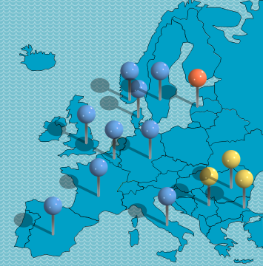
COST Action 15111 EUROMENE
  COST Member Countries
Austria, Belgium, Bosnia and Herzegovina, Bulgaria, Croatia, Cyprus, Czech Republic, Denmark, Estonia, Finland, France, Germany, Greece, Hungary, Iceland, Ireland, Italy, Latvia, Lithuania, Luxembourg, Malta, Montenegro, The Netherlands, Norway, Poland, Portugal, Romania, Serbia, Slovakia, Slovenia, Spain, Sweden, Switzerland, Turkey, United Kingdom and the former Yugoslav Republic of Macedonia
Notes:
5 Countries

Slide 13
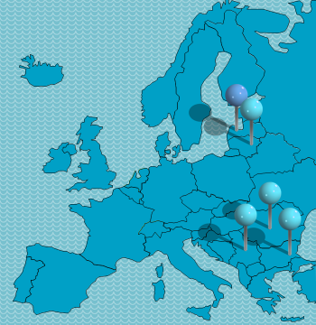
COST Action 15111 EUROMENE
  COST Inclusiveness Target Countries (ITCs)
  Bosnia-Herzegovina, Bulgaria, Cyprus, Czech Republic, Estonia, Croatia, Hungary, Lithuania, Latvia, Luxembourg, Malta, Montenegro, Poland, Portugal, Romania, Slovenia, Slovakia, the former Yugoslav Republic of Macedonia, Republic of Serbia and Turkey
Notes:
5 Countries

Slide 14
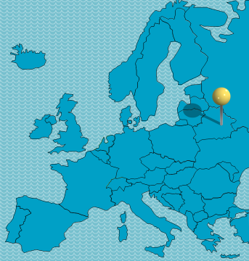
COST Action 15111 EUROMENE
  COST Near Neighbour Countries (NNC)
  Albania, Algeria, Armenia, Azerbaijan, Belarus, Egypt, Georgia, Jordan, Lebanon, Libya, Moldova, Morocco, the Palestinian Authority, Russia, Syria, Tunisia and Ukraine.
Notes:
1 Country

Slide 15
Management CA 15111 EUROMENE
MC Chair: Prof Modra Murovska (Latvia)
MC Vice-chair: Dr Eliana Lacerda (UK)
WG1Epidemiology
WG2 Biomarkers
WG3 Socio-economics
WG4 Clinical research/diagnostic criteria
WG5 Conferences, seminars, training schools
WG6 Dissemination & patient involvement
Dr Jesus Castro (Spain)
Prof Carmen Scheibenbogen (Germany)
Prof Derek Pheby (UK)
Dr Elin B Strand (Norway)
Prof Evelina Shikova-Lekova (Bulgaria)
Dr Lorenzo (Lorusso Italy)

Slide 16

ME/CFS – a global challenge

Slide 17
EUROMENE Proposal
First steps
Mapping of existing resources
Seeking agreement for standardising protocols
Establishing biobank platform and bioinformatics data repository

Slide 18
COST Action 15111 EUROMENE
Foreseen scientific, technological
and/or socio-economic impacts
Collaboration Synergy
Coordination
Translation
Notes:
Impact – benefit to society, arising from improved diagnostics and treatment, support to innovation process

Slide 19
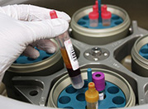
WG1 - Epidemiology
Individual datasets
Databases and registries
Biobanks
Standartisation
&
Harmonisation
Open ME/CFS research ressources platform

Slide 20

WG2 - Biomarkers
Neuroimaging
biomarkers
Infection biomarkers
Immunological biomarkers
Clinical correlated phenotypes
Metabolic biomarkers
ME/CFS translational platform with novel multimarkers

Slide 21
WG3 – Socio-economics
Opportunity-cost based disease costs
Medical cost
Care cost
Imputed cost
Predictive tool for socio-economic forecasts
Guideline cost-effectiveness forecasts

Slide 22
WG3 - Clinical research & diagnostic criteria
Diagnosis
Treatment
Stratification
Efficacy
Monitoring
Harmonised guidelines

Slide 23
WG4 - Conferences, seminars, training schools, STSMs
Early carrier investigators
  Preference in Short Term scientific missions
  Two Training schools
  Coaching in network
  Additional training sessions
  Strong integration into outreach activities
Annual seminars/workshops
Major conference at the end

Slide 24
First year Meetings
Riga 29-30 September 2016
  MC meeting, CG meeting, WG meeting
Berlin 27 January 2017
  One-day Working group meeting about synchronization progress
Barcelona 16-17 March, 2017
  Second CG meeting, WG meeting, First Workshop
Notes:
MC Management Committee, CG – Core Group;

Slide 25
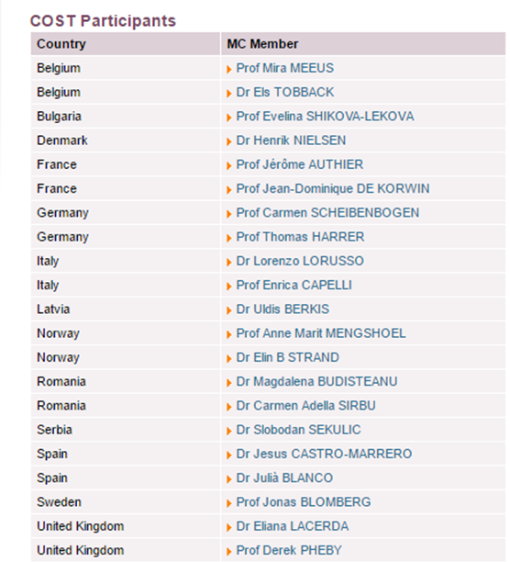
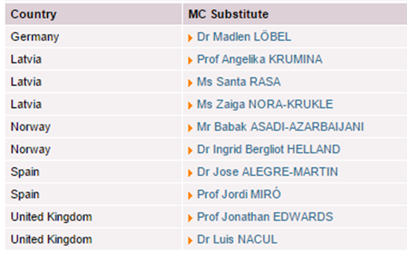
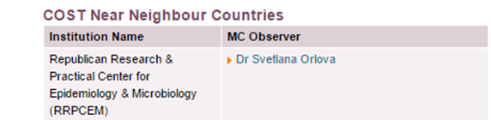
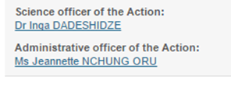
Thank you!

Slide 26

